Slide 1
Branch Prediction in SimpleScalar
Brooks Lombardy
David Austin

Slide 2
Overview
Problem Statement
Solution
SimpleScalar Branch Predictor Overview
Command Line Options
Data
Conclusion

Slide 3
Problem
Far too many combinations of branch prediction hardware to justify cost of implementing them all.
Reliable solution is needed to provide useful measures of branch prediction schemes.

Slide 4
Solution
Computer based simulation of proposed new implementations
SimpleScalar
  Simulator suite for many different parts of an architecture.
  Simulators for caches, out of order simulation, branch prediction

Slide 5
SimpleScalar Branch Prediction –sim-bpred
Capable of simulating two static and three dynamic predictors
  Not taken
  Taken
  Bimodal (Branch Prediction Buffer)
  2-level adaptive
  Combined bimodal and 2-level adaptive

Slide 6
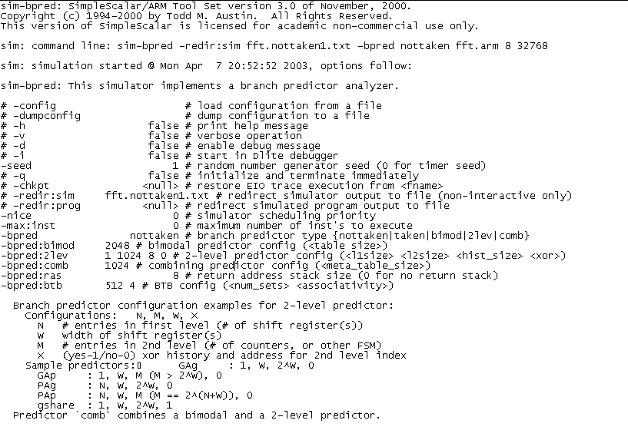
Sample Output 1

Slide 7
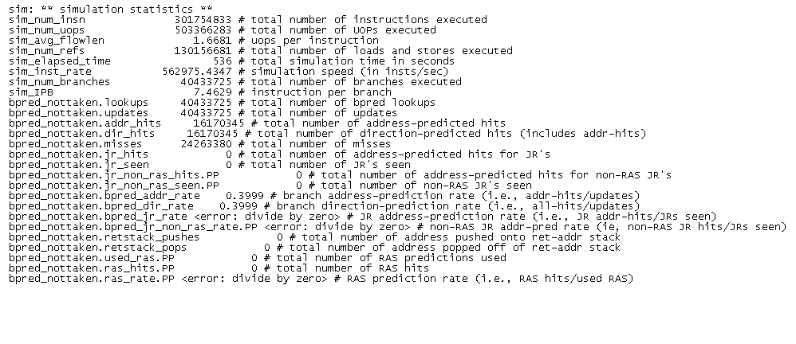
Sample Output 2

Slide 8
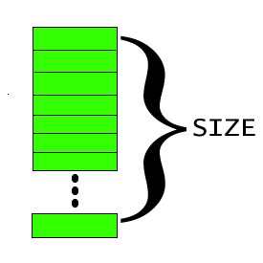
Bimodal Predictor
sim-bpred -bpred bimod -bpred:bimod <size>
  Size, the only user definable option specifies the number of entries in the Branch Target Buffer.
  Entries in the BTB are 2-bit counters.
  Default case for sim-bpred with no options is a bimodal predictor with 2k entries.

Slide 9
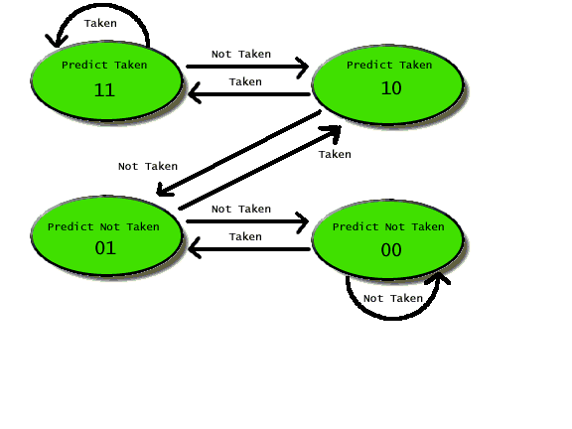
2 Bit Branch Predictor
Decrement if branch not taken
Increment if branch taken
Predict taken when counter is greater than 1/2 the maximum value, else not taken

Slide 10
Two Level Adaptive Predictor
sim-bpred -bpred 2lev -bpred:2lev <L1_size><L2_size><h_size><xor>
  L1_size: number of entries in the L1 table
  L2_size: number of entries in the L2 table
  h_size: history width
  xor: sets xoring between the history and the address in L2
Default values are 1, 1k, 8 and 0

Slide 11
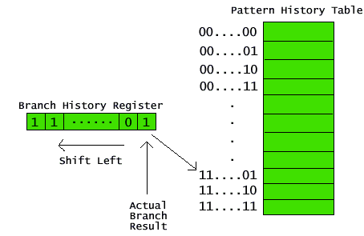
2 Level Adaptive Predictor
Level 1 is a shift register with h_size bits recording branch history.
Level 2 is the 2 bit predictor associated with the pattern in Level 1

Slide 12
Combined Predictor
sim-bpred -bpred comb -bpred:comb<size>
  size: number of entries in the combined predictor table
Default size = 1k

Slide 13
Miscellaneous Options
-bpred:ras <size>
  Specifies the number of entries in the address stack.
-bpred:btb <sets><assoc>
  Sets the associativity and number of sets for the branch prediction buffer.
*-bpred:spec_update <stage>
  Enables speculative update of the predictor
  stage can be either Decode (ID) or Writeback (WB)

Slide 14
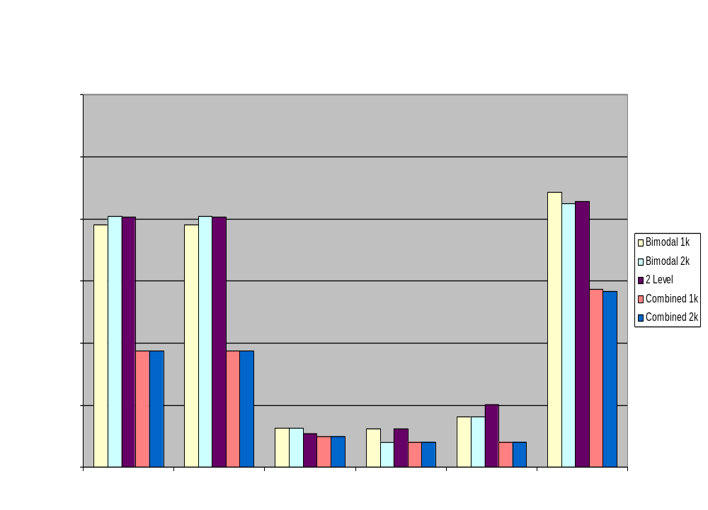

Slide 15
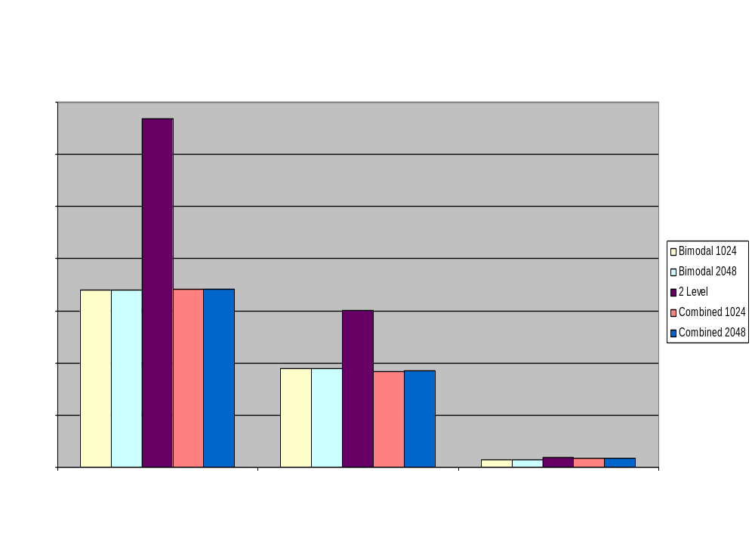

Slide 16

Conclusions
SimpleScalar can effectively be used to simulate various branch prediction methods.
Static prediction proved to be less effective in most cases.

Slide 17
Demo
./sim-bpred -bpred:2lev 1 1024 8 0 gcc00.peak.ev6 cccp.i -o cccp.s > cccp.out 2> cccp.err

